Slide 1



Machine learning as an auxiliary tool for computational chemistry
XXII Brazilian Symposium on Theoretical Chemistry
Dr. Henrique de Castro Silva Junior

Slide 2

Day 3 Datasets & RF & XGBoost

Slide 3

Decision tree

Slide 4
Decision Tree Model
A machine learning algorithm that uses a tree-like structure to make predictions
Can be used for both classification and regression problems
Root node
Consists of nodes, branches, and leaves
Nodes: tests or queries on input features
Branches: outcomes of the tests
Leaves: predictions or probability distributions over the target variable
Int. node
Leaf
Learns from the data by splitting the nodes based on some criteria until a stopping condition is met
Easy to interpret and visualize, but can also suffer from overfitting or underfitting if not properly pruned or regularized
Leaf
Leaf
Notes:
Impureza = grau de homogeneidade de cada nó.

Slide 5

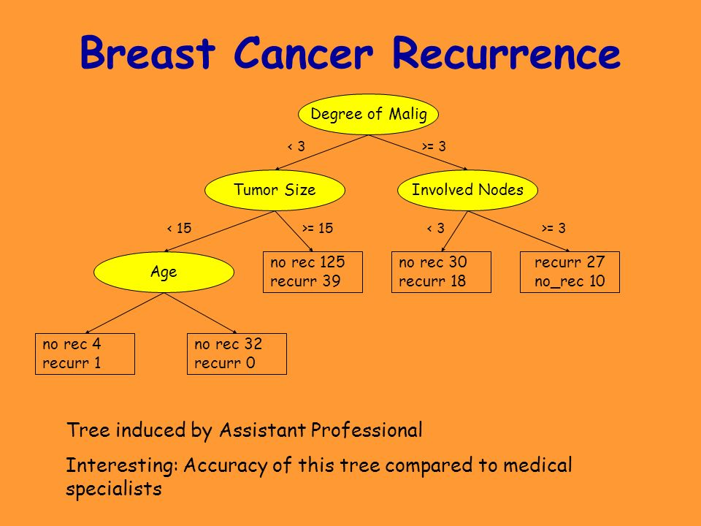
Decision Tree Model

Slide 6
Decision Tree Model
Overfitting the Data
They can be unstable, meaning that a small change in the data can lead to a large change in the structure of the optimal decision tree1.
They can be prone to overfitting, especially if the tree is too deep or not pruned properly.
They can be affected by noise, which can reduce the accuracy and generalization of the model.
They can have difficulty with continuous variables and regression problems, as they require discretization or binning of the values.
They can be biased by unbalanced classes or features that have more levels than others.
They use a greedy algorithm that may not find the global optimal solution.
They can be computationally expensive on large datasets, as they require complex calculations and sorting operations.
They can be hard to interpret if the tree is too large or complex.
accuracy
On training
On testing
Complexity of tree
A decision tree overfits the training data when its accuracy on the training data goes up but its accuracy on unseen data goes down
Notes:
30 cents. Coins {1, 15, 25}. Escolhe a maior: 25. Resta 5: escolhe 1 x 5.

Slide 7

Regression tree

Slide 8
Regression Tree Model
< 3.0
Regression trees are a type of decision trees that predict a continuous output variable, such as the concentration of a chemical, the pH of a solution, or the melting point of a compound.
Regression trees split the data into smaller and smaller subsets based on certain criteria, such as the value or the category of an input variable, and then assign a value to each leaf node based on the mean or the median of the data in that node.
Regression trees can handle different types of input variables, such as continuous, discrete, or categorical, and can capture nonlinear and interactive effects among them.
< 1.5
> 3.0
1.2, 1.4
2.0,1.7
Notes:
Impureza = grau de homogeneidade de cada nó.

Slide 9

Random forest

Slide 10
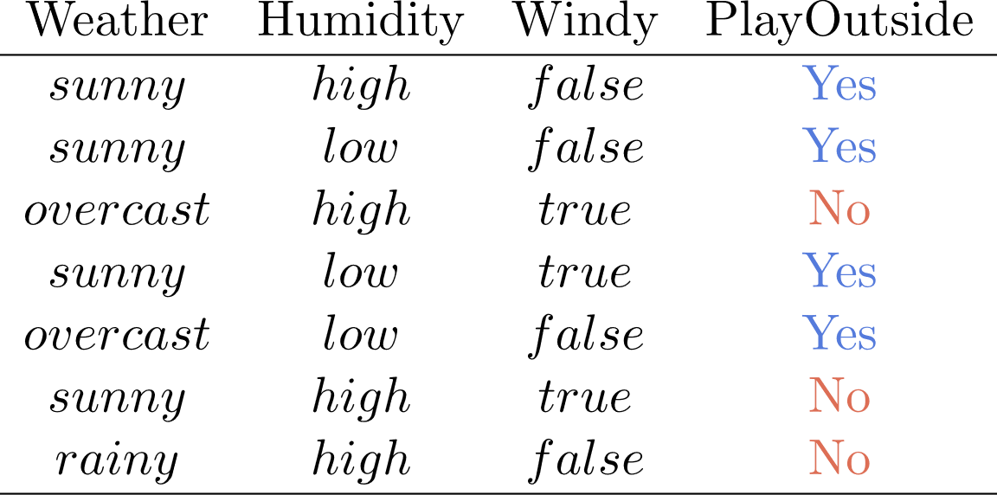
Random forest Model
A random forest is an ensemble of multiple decision trees that uses bootstrapping and feature bagging to create different subsets of data and features for each tree.
A random forest aggregates the predictions of each tree by using majority vote or average value to produce the final outcome.
A random forest tends to perform better than a decision tree on unseen data because it reduces overfitting and variance by averaging the results of different trees.

Slide 11
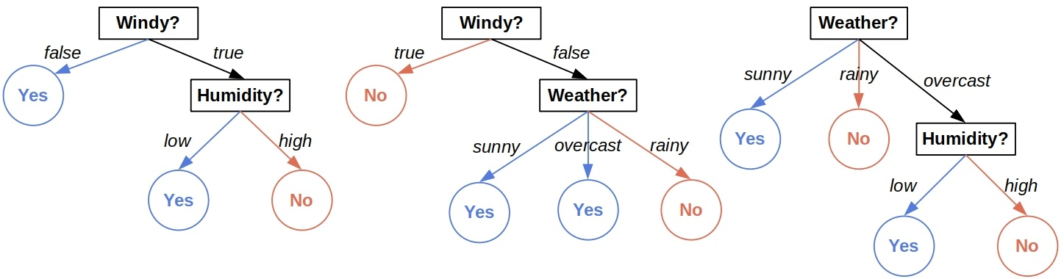
Random forest Model

Slide 12

In Python…

Slide 13
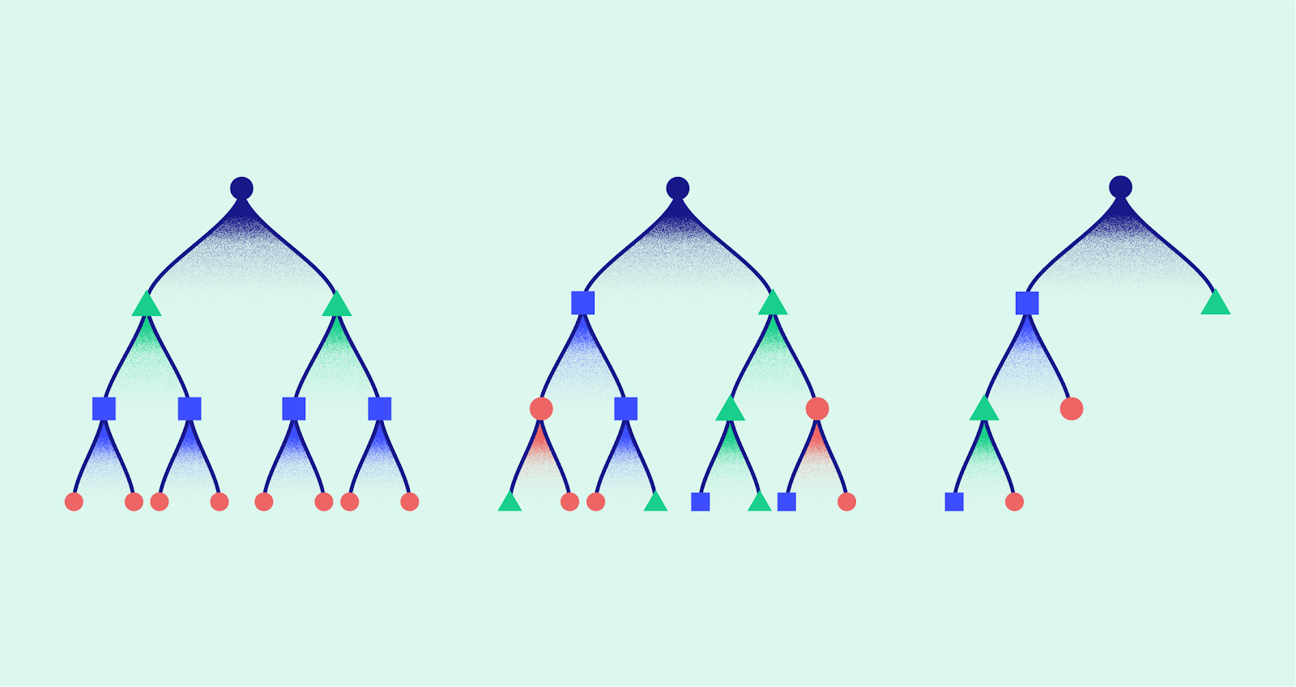
XGBoost

Slide 14
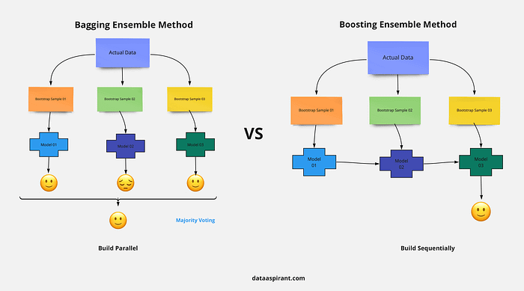

XGBoost Model
XGBoost is a sequential model that creates decision trees sequentially with adjustments made from the prior tree’s error.
It often works better with imbalanced datasets.
XGBoost models are able to counter overfitting by creating shallower trees.
However, it takes more time to train than Random Forest.

Slide 15
In Python…

Slide 16
Tomorrow: Working with Neural Networks
SBQT Day 4

